Slide 1

Real-time Autotuning Project
EE 4490 Design Project
July 16,2025
Anthony Nguyen, Benjamin Levario

Slide 2
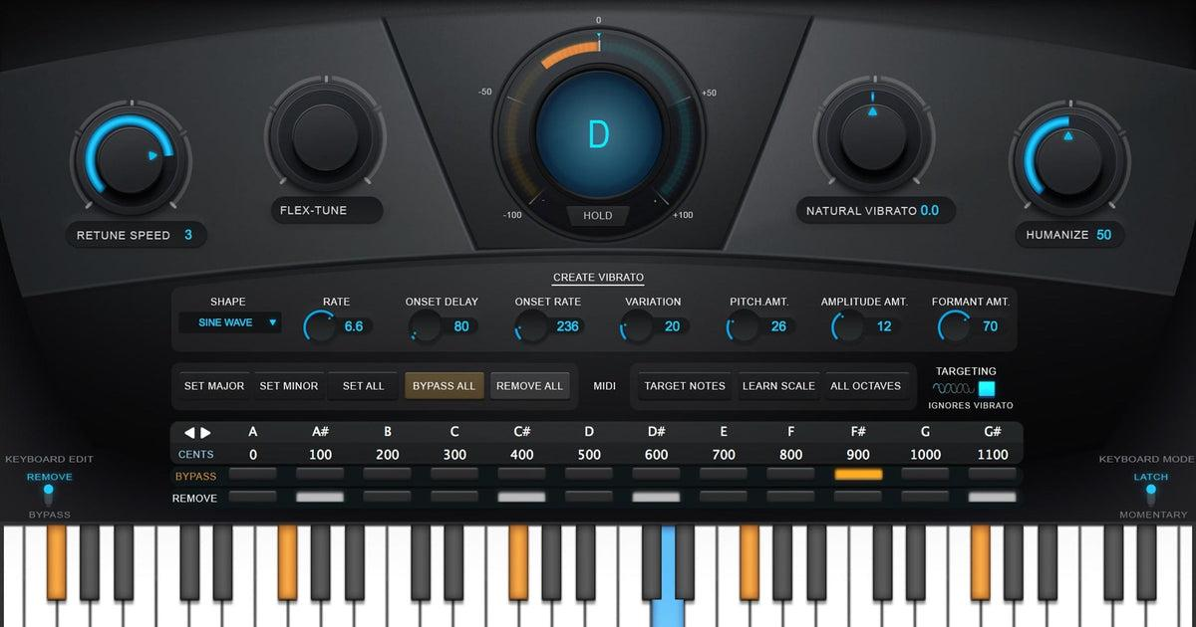
Antares Auto-Tune Realtime
Existing Product:
1
Notes:
Real World Product: Antares Auto-Tune Realtime X
Cost - $299*
Product Features
Apply Auto-Tune pitch-correction to a performance in realtime when tracking with Apollo interfaces
Correct vocals and other solo instruments transparently during mixdown
Create the iconic Auto-Tune vocal effect essential to modern pop, hip-hop, and electronic music
Use Classic Mode to get the gritty, glitchy "Auto‑Tune 5" sound made famous by Future, Bon Iver, and more
Fine-tune using Auto-Tune X's powerful Humanize, Vibrato, and Flex-Tune functions
Control target pitches or other Auto-Tune parameters in realtime using MIDI input

Slide 3

Auto-Tuning Major Steps
1
2
3
Pitch Detection
Pitch Correction
Audio Synthesis
Estimating the fundamental frequency of the audio over time.
Shifting the detected values to align with notes in the chosen scale.
Re-creating the audio with the corrected pitch using a technique.

Slide 4



Pitch Detection
Concept:
To accurately determine the fundamental frequency (the core pitch of an audio signal as it changes over time.
How it Works:
The audio is divided into small, overlapping segments. For each segment, the system analyzes it to determine its most dominant pitch.
Audio Input: The raw sound
Segment Length & Overlap: How audio is broken down into small, overlapping windows for analysis
Pitch Range: The minimum and maximum frequencies to search for pitches, helping to ignore noise.
Output:
A detailed map of the audio’s pitch changes over time.
Notes:
How it Works (Conceptual): The process involves analyzing the audio by dividing it into numerous small, overlapping segments. For each segment, the system identifies and extracts its most prominent pitch.
Audio Input: The raw sound material that needs to be analyzed.
Segment Length: The specific duration of each small audio portion that the system examines (e.g., approximately 46 milliseconds).
Segment Overlap: The degree to which consecutive audio segments overlap (e.g., 75% overlap). This overlap is crucial for smooth and continuous pitch tracking, helping to avoid any abrupt changes or gaps in the detected pitch contour.
Audio Quality (Sample Rate): The level of detail in the audio, typically measured in samples per second.
Pitch Range: A defined minimum and maximum frequency range within which the system is instructed to search for pitches (e.g., from a low C note to a high C note). Setting this range helps the system focus on relevant musical pitches and ignore extraneous noise.
Output: The outcome of this process is a detailed sequence of estimated fundamental frequencies. This sequence effectively maps out the audio's pitch movements over time.

Slide 5
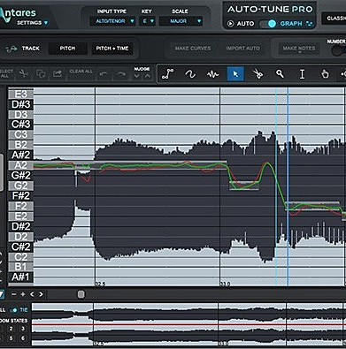
Pitch Correction
Pitch Conversion
Each detected frequency from the input audio is first converted to MIDI note number.
M = 12 * log₂(f / 440) + 69
Pitch Class
The MIDI notes is then reduced to its pitch class.
P = M (mod 12)
Closest Scale Note
The system identifies the closest note within the specified musical scale to the detected pitch class.
P_{scale} = argmin|D - P|
Notes:
Pitch Correction
Concept:
Pitch correction is the fundamental process in autotuning that adjusts the detected pitches of an audio signal to align perfectly with the specific notes within a chosen musical scale. The goal is to ensure the audio is precisely "in tune."
How it Works (Mathematical Process):
Pitch Conversion: Each fundamental frequency (f) detected from the audio input is initially converted into a standardized MIDI note number (M). This provides a universal way to represent musical pitches.
M=12log2​(440f​)+69 (Here, f is the frequency in Hertz, M is the MIDI note number, and 440 Hz represents the pitch of A4, which corresponds to MIDI note 69.)
Pitch Class Determination: The MIDI note (M) is then simplified to its "pitch class" (P). This is a value from 0 to 11 (where 0 is C, 1 is C#, ..., 11 is B), indicating the specific note name regardless of its octave.
P=M(mod12)
Finding the Closest Scale Note: The system identifies the target note within the selected musical scale (e.g., "C major" or "A minor") that is musically closest to the detected pitch class (P). This is done by comparing P with every pitch class (D) present in the chosen scale and selecting the D that has the smallest absolute difference.
Pscale = argmin​∣D − P∣ (This means: "Find the note D within the selected_key_degrees (the notes of your scale) that minimizes the absolute distance between itself and the detected pitch class P.")

Slide 6
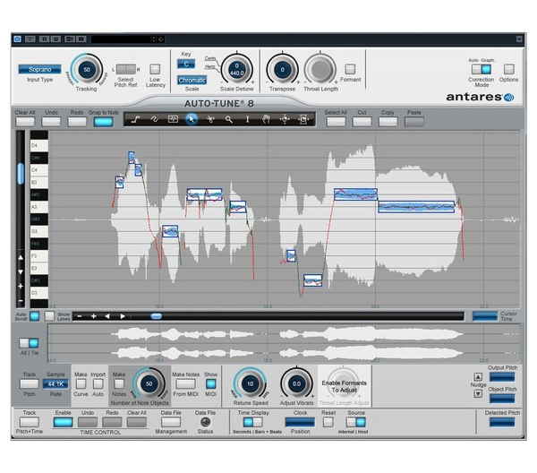
Date
Correction Calculation
The difference between the detected pitch class and the closest in-scale pitch class.
ΔP = P - P_{scale}
MIDI Adjustment
The original MIDI note is then adjusted by subtracting this calculated difference
M_{corrected} = M - ΔP
Frequency Conversion
The corrected MIDI note number is converted back into a precise frequency in Hertz.
ƒ_{corrected} = 440 · 2^{(M_corrected - 69) / 12}
Notes:
4. Correction Calculation: The difference (ΔP) between the detected pitch class (P) and the closest in-scale pitch class (Pscale​) is calculated. This value tells us how many semitones the detected pitch is off from its target.
ΔP=P−Pscale​
5. MIDI Adjustment: The original MIDI note (M) is then adjusted by subtracting this calculated difference (ΔP). This effectively shifts the pitch to the desired in-scale note.
Mcorrected​=M−ΔP
6. Frequency Conversion: Finally, the corrected MIDI note number (Mcorrected​) is converted back into a precise frequency (fcorrected​) in Hertz. This is the new, autotuned fundamental frequency.
fcorrected​=440⋅2(Mcorrected​−69)/12
Smoothing:
After each individual pitch correction, a median filter is applied to the entire sequence of corrected fundamental frequencies. This non-linear filter effectively smooths out any abrupt changes, jitters, or isolated spikes in the pitch contour, ensuring that the transitions between notes sound natural and not artificial or "robotic."
Benefits:
This meticulous process ensures that all vocals or instrumental parts precisely snap to the intended musical scale, resulting in a harmonically accurate and musically pleasing sound. The critical smoothing step preserves the natural fluidity of the performance, avoiding a choppy or overly synthesized effect.

Slide 7
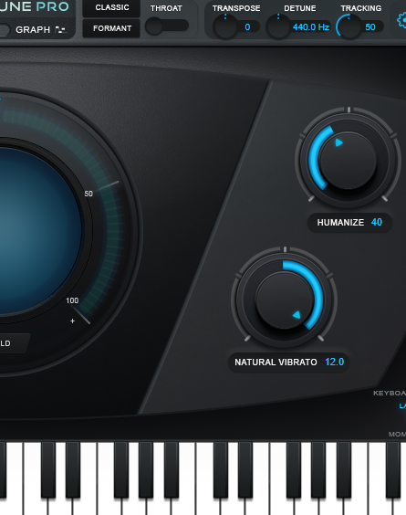

Audio Synthesis
Core Feature:
Rebuilding the audio signal with corrected pitch, making pitch adjustments sound natural and professional.
Utilizing PSOLA (Pitch Synchronous Overlap and Add):
This technique detects original pitch cycles, extracts small audio “grains,” repositions these grains based on the new, corrected pitch, and then smoothly overlaps and adds them to create the final, autotuned sound.
5 ms
RETUNE SPEED
12.0
NATURAL VIBRATO
40
HUMANIZE

Slide 8
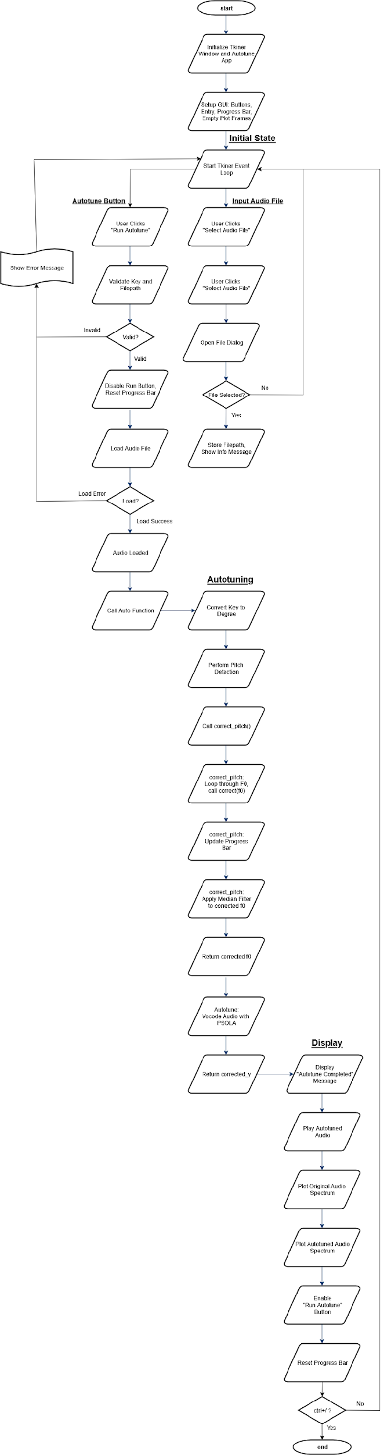
Flow Diagram

Slide 12

Demo

Slide 13
Biggest Challenges
1
2
3
No Real-time Autotune
Tech-Adjusted Features
Tight Schedule
The initial goal of achieving real-time autotune proved unfeasible due to limited experience processing large sample data with low latency constraints.
Given the time constraints of the summer semester, we were unable to fully realize the project's original scope.
By upgrading from microcontroller to full computer processing, we gained the necessary power to achieve similar feature of a real-time pitch correction.

Slide 14

References
Librosa:
https://librosa.org/doc/latest/index.html
McFee, Brian, Colin Raffel, Dawen Liang, Daniel PW Ellis, Matt McVicar, Eric Battenberg, and Oriol Nieto. “librosa: Audio and music signal analysis in python.” In Proceedings of the 14th python in science conference, pp. 18-25. 2015.

Slide 15
Thank you!

